Slide 1
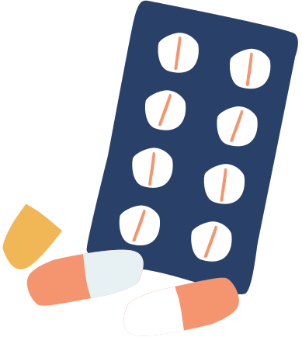


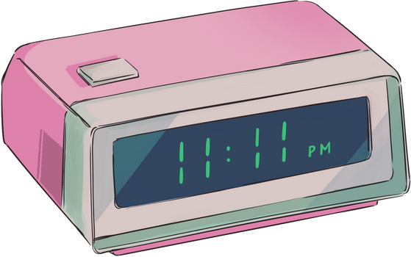
MEDICATION ADHERENCE APPLICATION
Group 7
Abdurrahman Ansari
Sahil Ketkar

Slide 2
Introduction
Medication non-adherence contributes to 50% of treatment failures and nearly 125,000 deaths annually in the U.S. [Stat Source: WHO].
Cost burden: $290 billion annually in avoidable healthcare costs in the U.S. [New England Healthcare Institute].
Chronic conditions like diabetes and hypertension often go unmanaged due to missed doses.
Adherence to these chronic diseases especially the communicable ones is very crucial to treat patients quickly.

Slide 3


Literature Review
Existing Approach
Our Approach
Traditional Reminder Cards: Limited engagement and lack of personalization.
General Mobile Apps: Basic reminders; lack of interactivity and AI-driven support.
AI Solutions (e.g., AiCure): Resource-heavy, mainly designed for clinical trials.
Combines intuitive reminders with a fine-tuned AI chatbot for user-specific assistance.
Designed to be scalable and accessible via mobile devices irrespective of the OS.

Slide 4




Methodology
UI
F/E & B/E
LLM
Built in Flutter (Dart language) for cross-platform compatibility and performance.
Firebase for real-time database synchronization and scalable cloud services.
User Interface (UI): Designed using Figma for intuitive navigation and user-friendliness.
Three screens: Home, Reminder, AI Chatbot.
Gemini API, fine-tuned with 173 medication-specific Q&A examples.

Slide 5
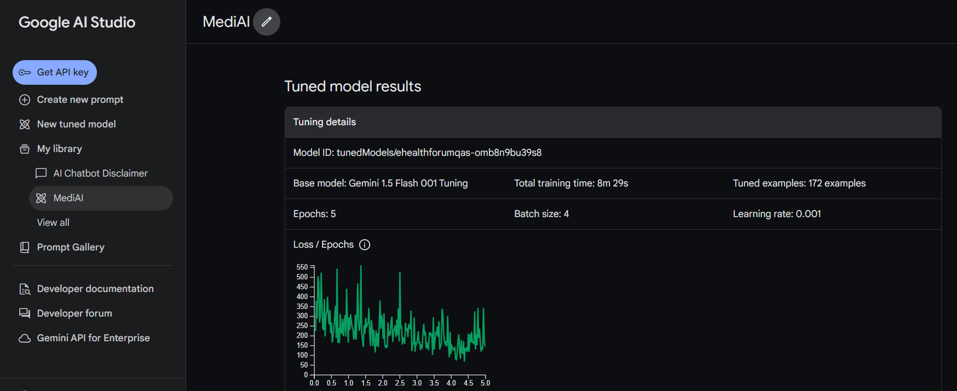
AI Chatbot: Gemini API

Slide 6
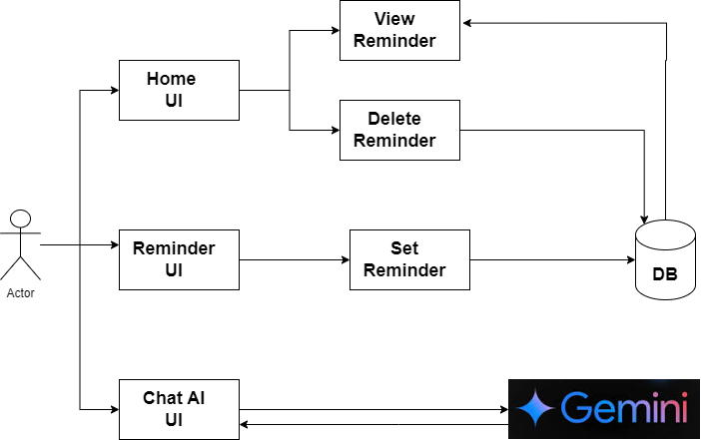
UML Architecture
API

Slide 7


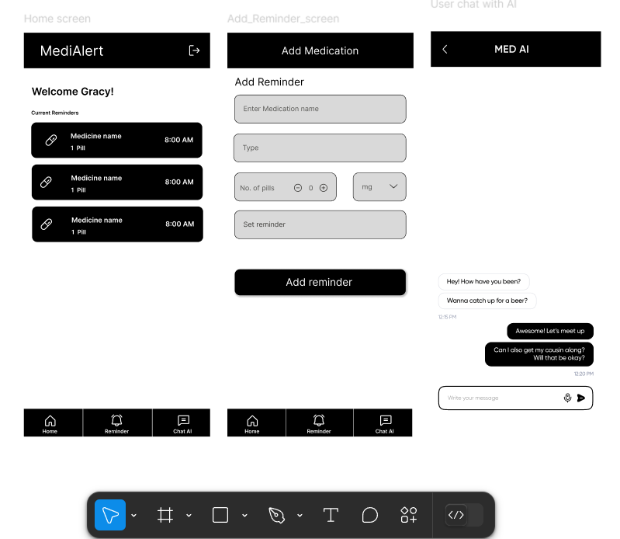
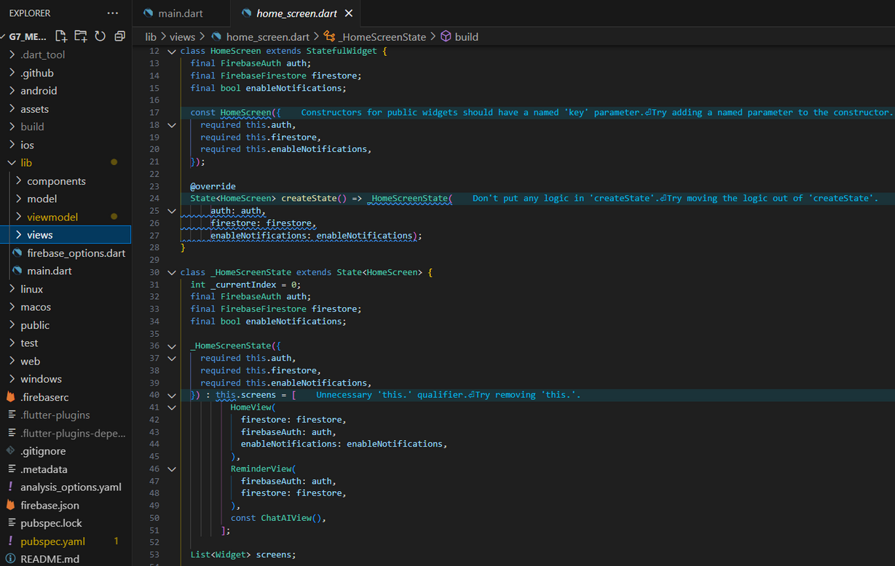
System Components
Frontend
Backend

Slide 8
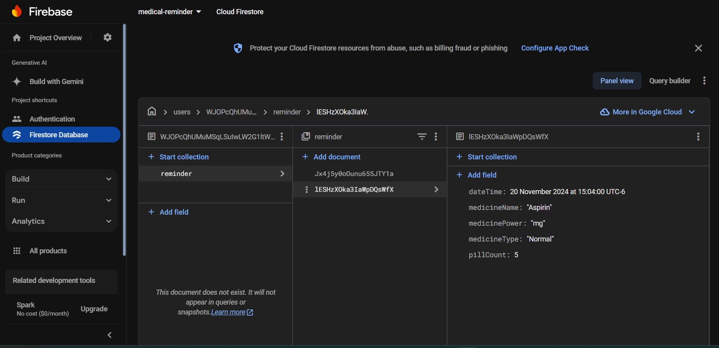
System Components
Database

Slide 9
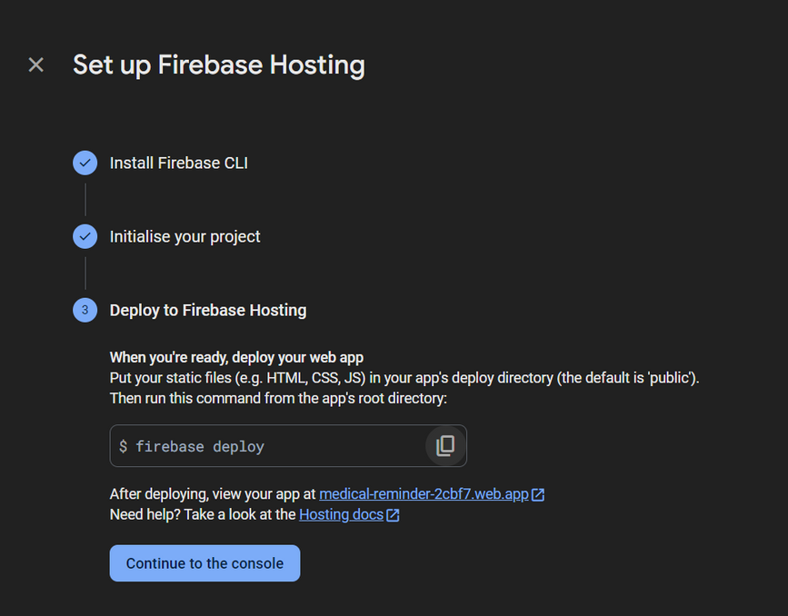
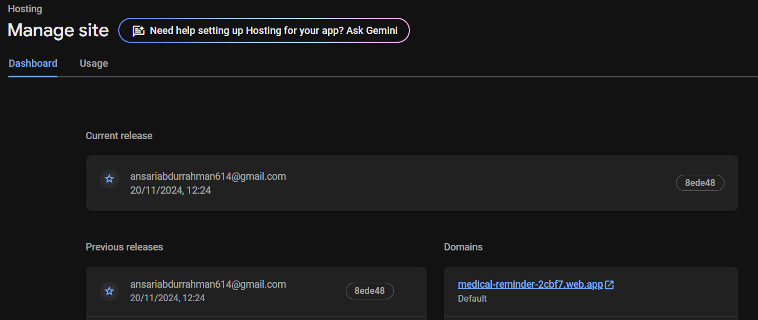
System Components
Cloud Deployment

Slide 10


System Components
API’s

Slide 11
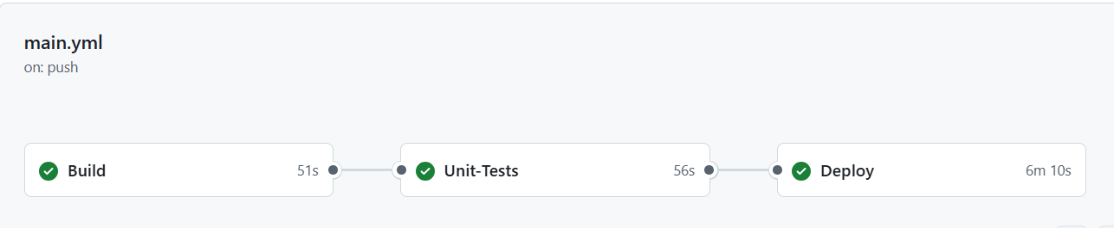
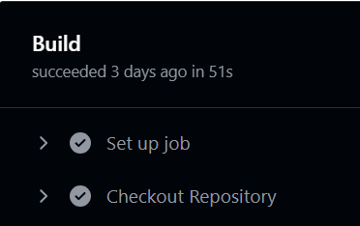


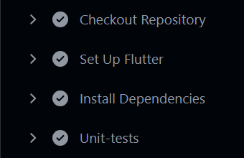
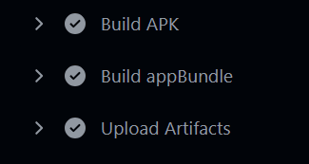

System Components
CI/CD

Slide 12
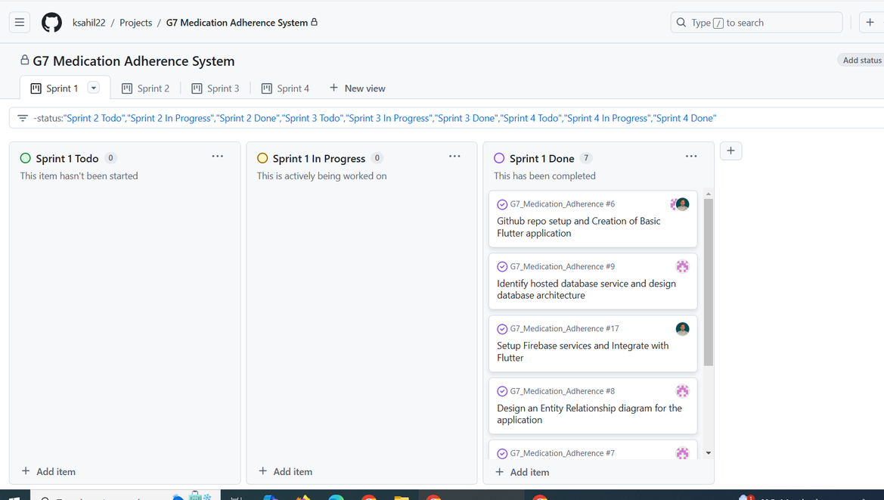
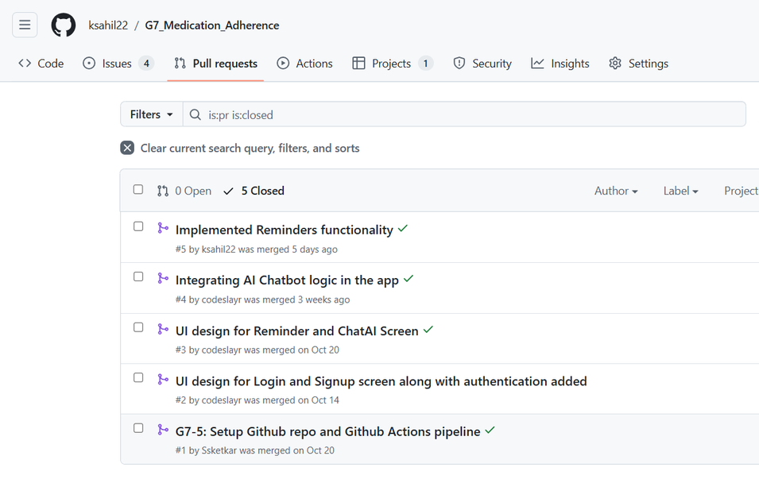
System Components
Project Management
Version Control

Slide 13
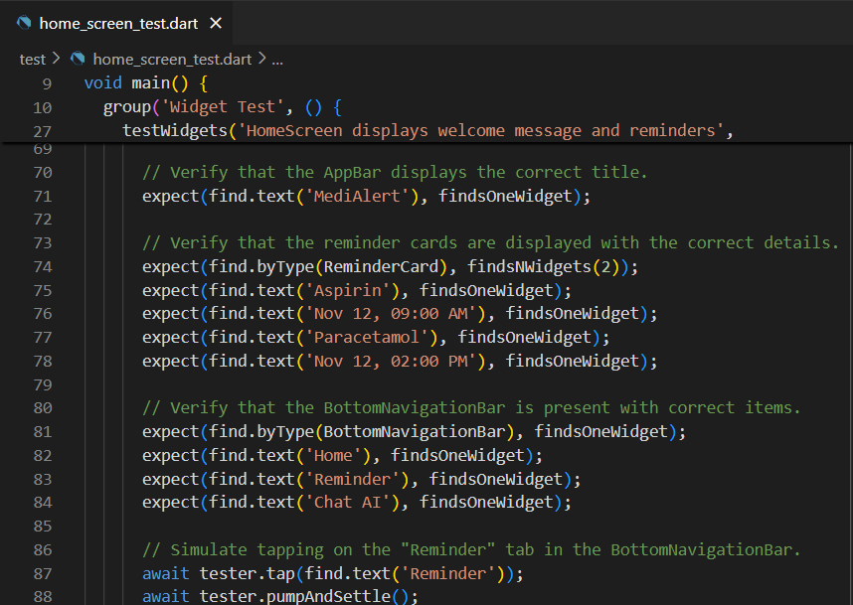
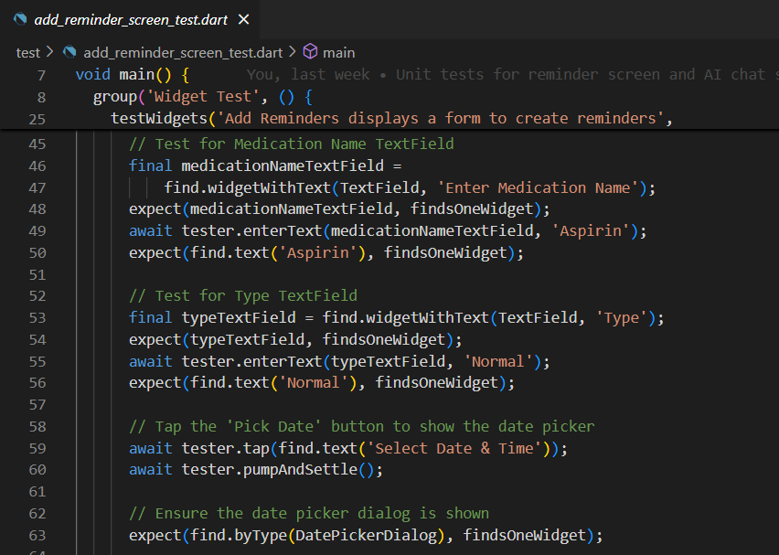
System Components
Testing

Slide 14
Results
Comparison Criteria
Clarity
Depth
Relevance
Measures understandability, unambiguity and informativeness
Good quality refers to the user can quickly grasp the result without extra clarification
evaluating the extensiveness of the response
Good depth refers to fundamental aspects of the subject were explored with simplicity
measures distance between a response and the query that prompted it.
Good relevance means addressing the issue at hand without digressing into extraneous topics

Slide 15


Comparision Criteria
Engagement
Overall Quality
Measures how well the response keeps the user engaged
A higher score in engagement represents those responses that are interactive and predict what the user will need
Evaluates all aspects including clarity, depth, relevance, engagement
Generalized score of the response in terms of usefulness and effectiveness

Slide 16
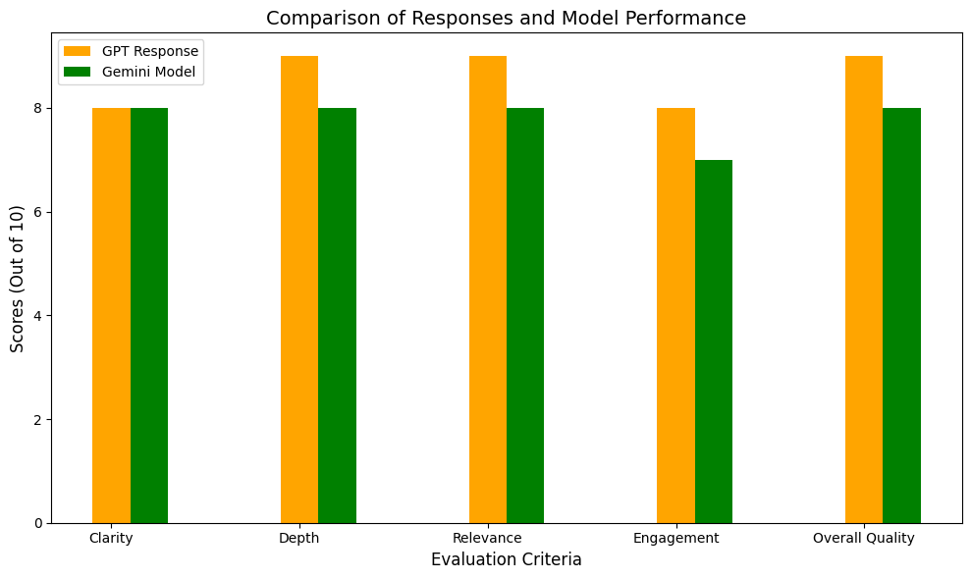
Fine-Tuned Gemini model vs GPT

Slide 17
Discussions(limitations and future work)
Reminders
AI model
Feedback & Analysis
Configuration Enhancement
Full screen Reminders
Support more medication details
Increase sample size for data model
More questions in sample size means improved model
User centric feature addition
Generating reports on user’s medication adherence

Slide 18
DEMO

